Slide 1
System Analysis and Design CT026-3-1
Analysis

Slide 2
Topic & Structure of the lesson
Systems Analysis
List FIVE (5) questions which could be used in an interview to determine user requirements
List and describe the SEVEN (7) interview steps
List SIX (6) fact-finding techniques

Slide 3
Learning Outcomes
By the end of this lecture, YOU should be able to know about:
Requirement Gathering Techniques
Interview
Document review
Observation
Surveys and questionnaires
Types of Requirements

Slide 4
Key Terms you must be able to use
If you have mastered this topic, you should be able to use the following terms correctly in your assignments and exams:
Fact-finding
Interview
Sampling
Questionnaire
Observation

Slide 5
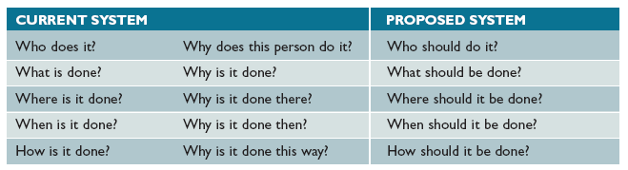
Questions asked in search of facts are :
WHO
WHAT
WHERE
WHEN
HOW
WHY

Slide 6



Fact-finding techniques
Interview
Document review
Observation
Sampling
Research
Surveys and questionnaires

Slide 7
Interview
planned meeting during which you can obtain information from another person.
Skills are required to plan, conduct and document interviews.
An information-gathering which is a directed conversation with a specific-purpose that uses a question and answer format.
Most important is seek the opinion of the person you are interviewing as opinion are more important than facts

Slide 8
Interview
Step 1: Determine the people to interview
Select the right people and ask the right questions
Don’t rely on just an organisation chart
Decide on group and/or individual interviews
Step 2. Establish objectives for the interview
Determine the areas to be discussed
List the facts you need to gather
Upper management provides the big picture
Users can give you specific details

Slide 9
Interview
Step 3. Develop interview questions
Decide what to ask and how to phrase the question
The same question to different people - for comparison
Open ended questions encourage spontaneous and unstructured responses
Close ended questions limit the response - used to verify facts
Range of response questions limit the response – uses a scale
On a scale of 1 to 10, with 1 the lowest and 10 the highest, how effective was your training?

Slide 10
Interview
Step 4. Prepare for the interview
Careful preparation is essential because an interview is an important meeting and not just a casual chat
Limit the interview to no more than one hour
Verify time, place, length, and topics via e-mail
Ask the interviewee to have samples available

Slide 11
Interview
Step 5. Conduct the interview
Develop a specific plan for the meeting
Begin by introducing yourself, describing the project, and explaining your interview objectives
Engaged listening
Allow the person enough time to think about the question
After an interview, you should summarize the session and seek a confirmation

Slide 12
Interview
Step 6. Document the interview
Note taking should be kept to a minimum
After conducting the interview, you must record the information quickly
After the interview, send memo to the interviewee expressing your appreciation
Note date, time, location, purpose of the interview, and the main points you discussed so the interviewee has a written summary and can offer additions or corrections

Slide 13
Interview
Step 7. Evaluate the interview
In addition to recording the facts obtained in an interview, try to identify any possible biases

Slide 14
Interview
Unsuccessful Interviews
No matter how well you prepare for interviews, some are not successful
Misunderstanding or personality conflict could affect the interview negatively, or the interviewee might be afraid that the new system will eliminate or change his or her job
Find a way to conclude an unsuccessful meeting
Consider alternatives

Slide 15
Quick Review Question
You are asked to develop a student registration system, what are the questions that you may ask in search of facts? (Hint: use following inquiry expressions )
WHO
WHAT
WHERE
WHEN
HOW
WHY

Slide 16
Summary of Main Teaching Points
Systems Analysis
Questions asked in search of facts
Fact-finding techniques
Interviews

Slide 17
Document Review
Review existing system documentation
Obtain copies of actual forms and documents
Review blank copies of forms
Review samples of completed forms
Review software documentation

Slide 18
Observation
Ask questions about present system operation
Observe all steps in the processing cycle
Examine each form, record and report
Consider each person working with the system
Talk to people who receive current reports
Consider the Hawthorne Effect
Productivity seemed to improve whenever workers knew they were being observed

Slide 19
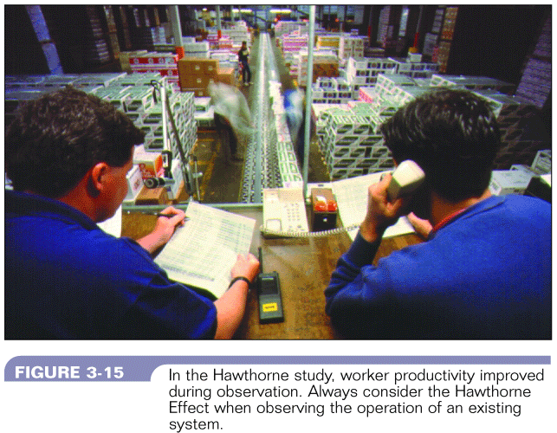
Observation – Hawthorne Effect
Figure 7-1 :Hawthorne Effect
Systems Analysis & Design (4th Edition) – Shelly Cashman Series

Slide 20
Questionnaires and Surveys
Brief and user-friendly
Clear instructions
Questions in logical order
Simple wording to avoid misunderstanding
Avoid leading questions
Open-ended questions are difficult to tabulate
Limit questions raising concern / negative issues
Section for general comments
Test the questionnaires in advance

Slide 21
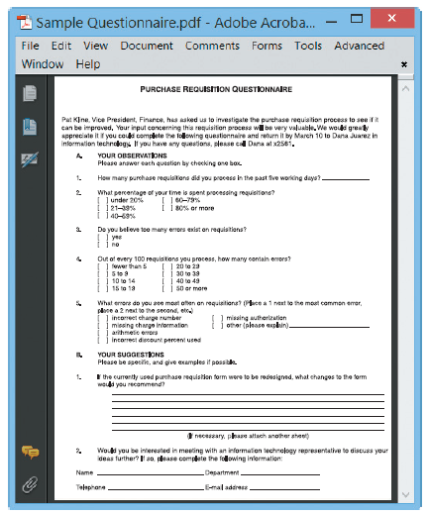
Questionnaires and Surveys
FIGURE 4-23 Online version of a sample questionnaire. Does it follow the suggested guidelines?

Slide 22
Sampling
process of collecting examples of actual documents
There are several techniques of sampling:-
Systematic sample : Select every tenth customer for review
Stratified sample : Select five customers from each of four postal codes
Random sample : Any 20 customers
Main objective : to ensure representation of the overall population accurately
Should be considered for interviewing or questionnaires

Slide 23
Research
Journals, periodicals, books
Internet sites
Hardware and software vendors
Independent firms that provide information
Newsgroups
Professional meetings, seminars, discussions
Site visits to observe a system in use

Slide 24
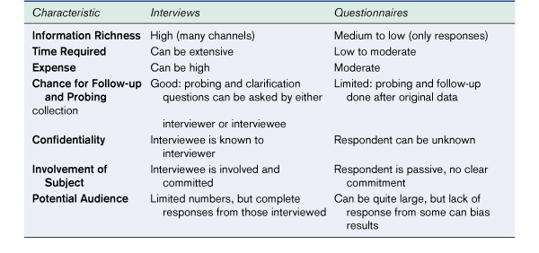
Interviews vs. Questionnaires
Figure 7.3 – Comparison of Interviews and Questionnaires
Modern Systems Analysis and Design, 3/e - Jeffrey A. Hoffer Joey F. George Joseph S. Valacich

Slide 25
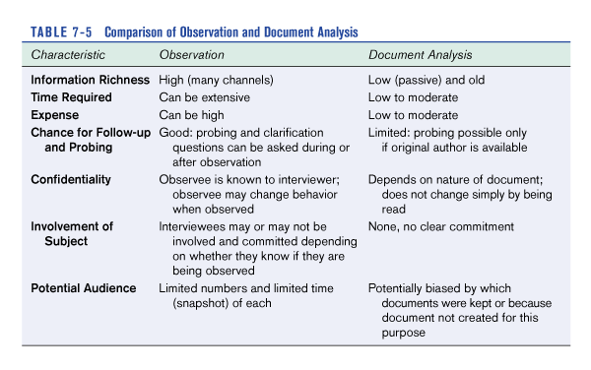
Observation vs. Document Analysis
Figure 7.4 – Comparison of Observation and Document Analysis
Modern Systems Analysis and Design, 3/e - Jeffrey A. Hoffer Joey F. George Joseph S. Valacich

Slide 26
Recording Facts
Keeping accurate records of interview, facts, ideas and research is important to successful systems development
Basic rule is to write it down
Principles to follow when recording facts are:-
Record all information as soon as you obtain it.
Use simplest recording method
Record findings properly so that it can be understood by someone else – not a member of the IS dept
Arrange documentation so that information can be brought together and coordinated

Slide 27
Software tools for recording the facts
CASE Tools (Computer-aided systems engineering) tools
Powerful programs that help systems analysts develop and maintain information systems
Provide an overall framework for systems development
Support a wide variety of design methodologies
Two CASE categories :
Upper CASE tools : support modeling process and produce a logical design of the information system
Lower CASE tools : speed the development process by generating source code based on the logical model

Slide 28
Software tools for recording the facts
Word processing
Create reports, summaries, tables and forms
Prepare standard documentation
Organize presentation with templates, bookmarks, annotations, revision control, index
Create fill-in forms to conduct surveys and questionnaires

Slide 29
Software tools for recording the facts
Spreadsheet
Track and manage numerical data or financial information
Generate graphs and charts that display the data and show possible patterns
Use statistical functions to tabulate and analyze questionnaire data

Slide 30
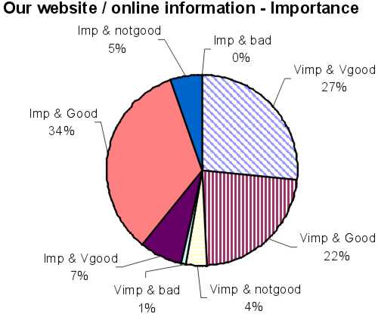
Software tools for recording the facts
Spreadsheets
Figure 7-5 : Sample Pie Chart
Retrieved from : http://www.lboro.ac.uk/computing/info/images/web-imp.jpg

Slide 31
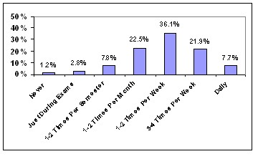
Software tools for recording the facts
Spreadsheets
Figure 7-6 : Sample Histogram
Retrieved from : http://www.library.tufts.edu/tisch/bibliotech/btc34.htm

Slide 32
Software tools for recording the facts
Database
To manage information about events, observations and samples
To manage the details of a complex project, create queries to retrieve specific information, and generate reports
Presentation graphics
For organizing and developing formal presentations
To create organization charts which can be included in written reports and management presentations

Slide 33
Software tools for recording the facts
Personal Information Managers
To keep track of meetings, interviews, appointments, and deadlines that are weeks or months in the future
To manage tasks and provide a personal calendar and a To-Do list, with priorities and the capability to check off completed items

Slide 34

System Requirement Specifications (SRS)
Structured collection of information that contains the finalized requirements of a system
Contains finalized requirement for System Design
Popular Requirement groups;
Functional Requirements
Non-Functional Requirements
Architecture Requirements
Business Requirements
System / Technical Requirements
User / Stakeholders Requirements
Security Requirements
User Interface Requirements, etc

Slide 35

Types of Requirements
Functional (solution) requirements
Usually detailed statements of capabilities, behavior, and information that the solution will need.
Examples include formatting text, calculating a number, modulating a signal. They are also known as capabilities.
Non-Functional Requirements
specifies criteria that can be used to judge the operation of a system, rather than specific behaviors.
Often considers the quality aspects of the new system, such as testability, maintainability, extensibility and scalability
Example: Availability

Slide 36
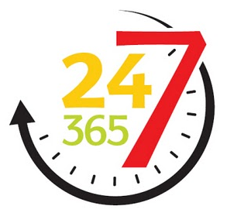
Availability % | Downtime per year | Downtime per month
90% ("one nine") | 36.5 days | 72 hours
95% | 18.25 days | 36 hours
97% | 10.96 days | 21.6 hours
98% | 7.30 days | 14.4 hours
99% ("two nines") | 3.65 days | 7.20 hours
99.5% | 1.83 days | 3.60 hours
99.8% | 17.52 hours | 86.23 minutes
99.9% ("three nines") | 8.76 hours | 43.8 minutes
99.95% | 4.38 hours | 21.56 minutes
99.99% ("four nines") | 52.56 minutes | 4.38 minutes
99.995% | 26.28 minutes | 2.16 minutes
99.999% ("five nines") | 5.26 minutes | 25.9 seconds
99.9999% ("six nines") | 31.5 seconds | 2.59 seconds
99.99999% ("seven nines") | 3.15 seconds | 262.97 milliseconds
99.999999% ("eight nines") | 315.569 milliseconds | 26.297 milliseconds
99.9999999% ("nine nines") | 31.5569 milliseconds | 2.6297 milliseconds

Slide 37

Types of Requirements
Architectural requirements
explain what has to be done by identifying the necessary systems structure and systems behavior
Business requirements
High-level statements of the goals, objectives, or needs of an organization.
Systems / Technical Requirements
The infrastructure that the new system needs to run on.
Minimum Hardware requirements such as server, storage space, processing power, etc.
Software needs such as OS, applications, plug-ins, etc.
Networking needs such as bandwidth, protocols etc.

Slide 38
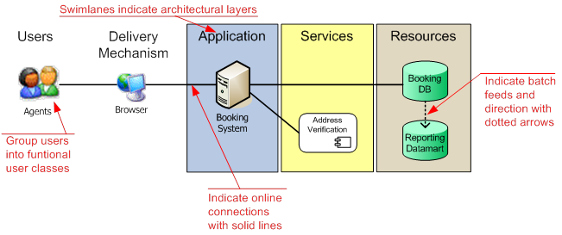
Architectural requirements

Slide 39
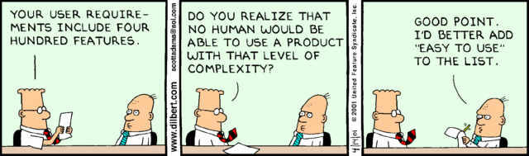
Types of Requirements
User (stakeholder) requirements
Mid-level statements of the needs of a particular stakeholder or group of stakeholders.
They usually describe how someone wants to interact with the intended solution.

Slide 40
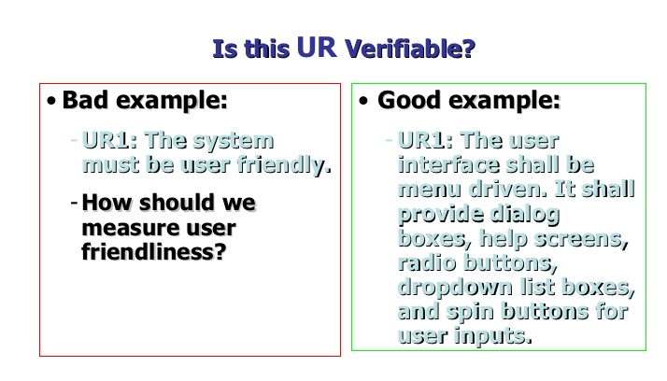

Slide 41

Types of Requirements
Security Requirements
The types and levels of security that the new system needs.
Authorization levels, Encryptions, etc.
User Interface Requirements
Specific design criteria for the user interface.
Color, language, etc.

Slide 42
Quick Review Question
Named some techniques for requirement elicitation?
What is the Hawthorne Effect?

Slide 43
Summary of Main Teaching Points
Systems Analysis
Fact-finding techniques
Document review
Observation
Surveys and questionnaires
Sampling
Research
Recording facts
Principles to follow
Software tools used

Slide 44
Question and Answer Session
Q & A

Slide 45
What we will cover next
System Analysis – Feasibility Study

